Slide 1
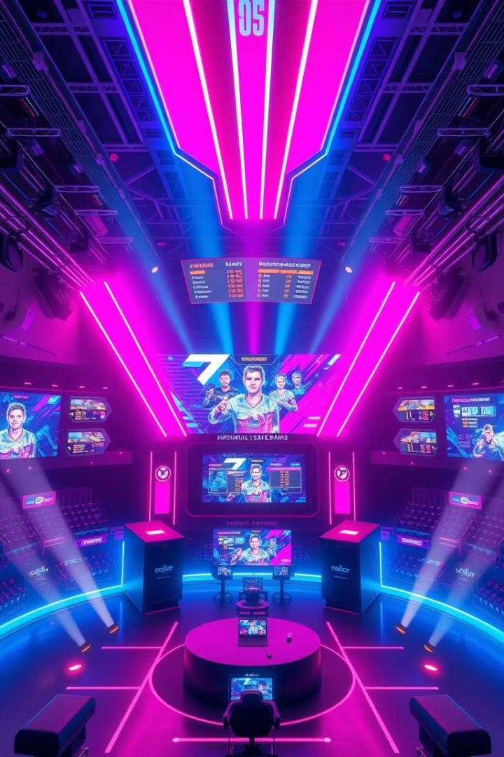
Game Hub – Online Tournament Platform
Game Hub is a full-stack web application. It simplifies online tournament management. This project was developed by Muhammad Ammar for the Web Development course, Spring 2025.

Slide 2
Introduction to Game Hub
What is Game Hub?
Why was it built?
Game Hub is a platform for online tournament organization. It provides a centralized system.
It addresses the challenges of manual tournament setup. It simplifies player and prize management.

Slide 3
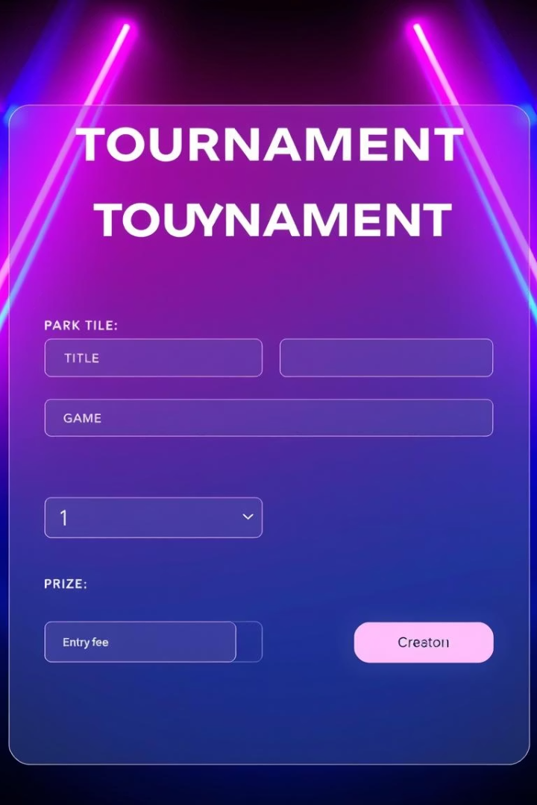



Core Features for Seamless Tournaments
Tournament Creation
Organizers define title, game, prize, and entry fee.
Player Management
Players join tournaments. A list of participants is displayed.
Winner Declaration
A "Declare Winner" button randomly selects a victor. The winner's name is displayed with a 🏆 icon.

Slide 4

Robust Technology Stack
Frontend
Developed with React and Vite for a dynamic interface.
Backend
Powered by Node.js and Express.js for server-side logic.
Database
MongoDB manages all tournament and player data.
Tools
Axios handles API calls. Nodemon aids development. Netlify hosts the frontend.

Slide 5




Project Structure Overview
Client Folder
Contains all frontend React code.
Server.js
The main entry point for the backend server.
Backend Modules
Includes controllers, routes, and models for structured backend operations.

Slide 6



Hosting and Deployment Strategy
Frontend on Netlify
Accessible at Game Hub Link.
Local Backend
Backend runs on a local Node.js server.

Slide 7
Challenges and Solutions
npm Script Errors
1
Resolved permissions and script execution issues.
Tournament Join Logic
2
Implemented robust logic for player participation.
Winner Bug Fixes
3
Addressed issues with random winner declaration.

Slide 8
Key Learning Outcomes
This project provided significant learning experiences.
Hands-on integration of React and Express.
Mastery of CRUD operations with MongoDB.
Practical experience with Netlify hosting and deployment.
Simulated a real-world team project execution process.
Developed by Muhammad Ammar, Farhan Iftikhar, Kamran Hashim, and Aman Sheikh. Supervised by Shoaib Idrees for the Web Development course, Spring 2025.

